Slide 1


My Autobiography: A Journey of Growth and Discovery
Welcome, dear reader, to my life story. This autobiography chronicles the moments that have shaped me, from childhood in Kisumu, Kenya, to pursuing my passions and finding my purpose.
Timothy opiyo

Slide 2
My Childhood in kisumu, Kenya
Kisumu, a town nestled amidst the beauty of Kenya, holds a special place in my heart. My childhood was a tapestry woven with the threads of family, community, and the vibrant culture of my homeland.
The Heart of Kenya
A Place of Wonder
A Place of Belonging
Kisumu was known for its scenic beauty. Lake Kisumu, with its flamingos, was a breathtaking sight. The town was a melting pot of cultures, where laughter, music, and dance filled the air.
The town was alive with adventure. We would spend hours exploring the natural wonders surrounding us, climbing trees, and playing games under the warm Kenyan sun.
The community embraced us. We shared stories, celebrations, and traditions. My early years in Kisumu instilled in me a deep sense of belonging and the importance of community.

Slide 3
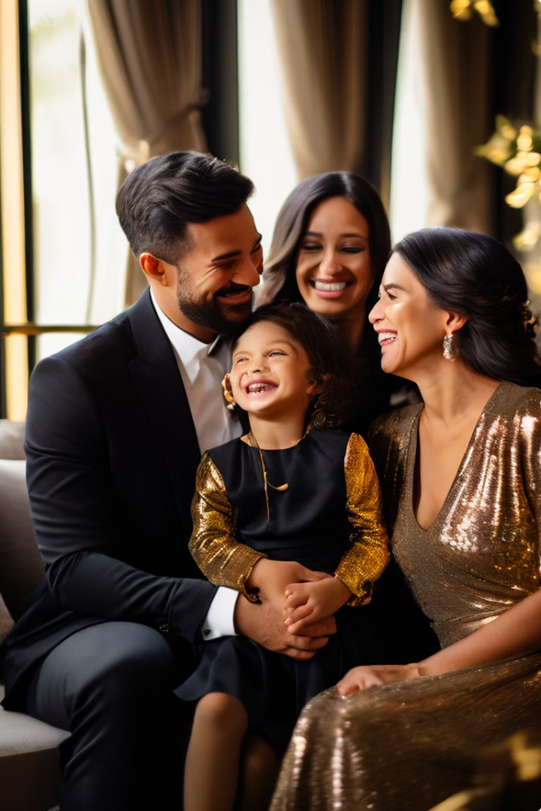

Growing Up in a Loving Family
My family was my anchor. My parents, Everlyn and Musa Robert Ouma, created a nurturing environment where I thrived. Their unwavering love and support formed the foundation of my character.
A Foundation of Love
My parents instilled in me values of kindness, compassion, and resilience. They taught me to embrace challenges and to find joy in the simplest of things.
A Tapestry of Traditions
We celebrated holidays and traditions together, creating cherished memories that shaped my understanding of family and culture.
A Place of Belonging
Our home was a sanctuary. It was a place where I felt safe, loved, and understood. My parents provided a stable and loving environment that allowed me to grow and flourish.

Slide 4

Lessons Learned from Siblings
Growing up with five siblings was an adventure in itself. We shared laughter, tears, and countless experiences that shaped our individual personalities and our bonds as a family.
1
The Importance of Cooperation
We learned to work together, to support each other, and to celebrate each other's successes. Our shared experiences fostered a strong sense of teamwork and unity.
2
The Value of Diversity
Each sibling brought a unique perspective to the family. We learned to appreciate our differences and to find common ground. Our diversity strengthened our bond.
3
The Power of Forgiveness
As siblings, we had our share of arguments and disagreements. But we learned the importance of forgiveness and reconciliation. Our ability to forgive each other deepened our love and respect.
4
The Strength of Family
Through thick and thin, we knew we had each other. Our family was our rock, providing unwavering support, encouragement, and love. My siblings shaped who I am today. I am grateful for their presence in my life.

Slide 5




Pursuing My Passion for Education
Education has always been a central theme in my life. It ignited a thirst for knowledge and a desire to make a meaningful impact on the world. My passion for learning became my driving force.
The Power of Knowledge
I recognized the transformative power of education. It could unlock potential, broaden horizons, and empower individuals to achieve their dreams.
A Commitment to Learning
I dedicated myself to my studies, immersing myself in books, lectures, and discussions. I sought knowledge with an insatiable curiosity, always eager to expand my understanding of the world.
Embracing Challenges
Education wasn't always easy. There were challenges and setbacks, but I persevered, driven by my determination to succeed. I learned the value of hard work and resilience.

Slide 6

Navigating Challenges and Setbacks
Life is not always a smooth journey. Challenges and setbacks are inevitable. However, they serve as valuable opportunities for growth and learning.
Challenges
Lessons Learned
Academic Struggles
Resilience, perseverance, and the importance of seeking support.
Personal Loss
The fragility of life, the value of relationships, and the importance of finding solace in loved ones.
Financial Hardship
Resourcefulness, adaptability, and the importance of prioritizing needs.

Slide 7




Discovering My Purpose and Calling
Through the challenges and triumphs, I began to understand my purpose in life. I discovered my calling, the unique contribution I could make to the world.
Connecting with Others
I realized that I had a deep desire to connect with people on a meaningful level, to build bridges of understanding, and to make a positive difference in their lives.
Sharing Knowledge
I recognized the power of knowledge to transform lives. I wanted to share what I had learned, to empower others, and to contribute to the betterment of society.
Making a Global Impact
I aspired to make a difference on a larger scale. I wanted to address global challenges, to work towards a more just and equitable world.

Slide 8

Reflections and Future Aspirations
Looking back on my journey, I am filled with gratitude for the experiences that have shaped me. I am excited to embrace the future, to continue learning, growing, and making a meaningful contribution to the world.
1
Embracing Opportunities
I am open to new opportunities and challenges. I believe that each experience holds valuable lessons and contributes to my growth.
2
Continual Learning
I am committed to lifelong learning. I will continue to seek knowledge, to expand my horizons, and to stay relevant in a rapidly changing world.
3
Making a Difference
I want to leave a lasting legacy. I aspire to make a positive impact on the lives of others and to contribute to a better future for all.

